Slide 1

PORTFOLIO ANALYSIS HINDUSTAN UNILEVER LIMITED

Slide 2
PORTFOLIO ANALYSIS HINDUSTAN UNILEVER LIMITED

Slide 3

INTRODUCTION TO PORTFOLIO ANALYSIS
Definition
Portfolio Analysis is the process of reviewing or assessing the elements of the entire portfolio of securities or products in a business
Identify the status and potential of various businesses regarding resource use and generation.
Formulate appropriate portfolio strategies.
Objective

Slide 4
INTRODUCTION TO PORTFOLIO ANALYSIS
Definition
Portfolio Analysis is the process of reviewing or assessing the elements of the entire portfolio of securities or products in a business
Identify the status and potential of various businesses regarding resource use and generation.
Formulate appropriate portfolio strategies.
Objective
Key Issues Addressed
Should there be a change in the current ?
Which businesses should be developed further ?
Which businesses should be harvested or divested ?
Portfolio analysis assists in the
formulation of corporate strategy
focused on resource generation and
allocation.
Corporate Strategy

Slide 5
INTRODUCTION TO PORTFOLIO ANALYSIS
Definition
Portfolio Analysis is the process of reviewing or assessing the elements of the entire portfolio of securities or products in a business
Identify the status and potential of various businesses regarding resource use and generation.
Formulate appropriate portfolio strategies.
Objective
Key Issues Addressed
Should there be a change in the current ?
Which businesses should be developed further ?
Which businesses should be harvested or divested ?
Portfolio analysis assists in the
formulation of corporate strategy
focused on resource generation and
allocation.
Corporate Strategy

Slide 6

MODELS FOR PORTFOLIO ANALYSIS
Common Models
.
Boston Consulting Group (BCG) Matrix
GE Multifactor Portfolio Matrix
Evaluate business performance and inform strategic decisions regarding investment and resource allocation.
It helps businesses understand their product’s strengths and weaknesses and make strategic decisions about their product lines.
Purpose
Concept
Axes Explanation
The BCG Matrix evaluates businesses based on two variables: market growth rate and relative market share.
Vertical: Market Growth Rate (high to low)
Horizontal: Relative Market Share (high to low)

Slide 7
MODELS FOR PORTFOLIO ANALYSIS
HUL IN THE BCG MATRIX
Boston Consulting Group (BCG) Matrix
Common Models
Four Categories
Concept
.
The BCG Matrix evaluates businesses based on two variables: market growth rate and relative market share.
Vertical: Market Growth Rate (high to low)
Horizontal: Relative Market Share (high to low)
GE Multifactor Portfolio Matrix
Evaluate business performance and inform strategic decisions regarding investment and resource allocation.
It helps businesses understand their product’s strengths and weaknesses and make strategic decisions about their product lines.
STARS: High market share, high growth (e.g., Surf excel).
CASH COWS: High market share, low growth (e.g., Closeup).
QUESTION MARKS: Low market share, high growth (e.g., Sunsilk).
DOGS: Low market share, low growth (e.g., Taaza).
Purpose
Axes Explanation

Slide 8
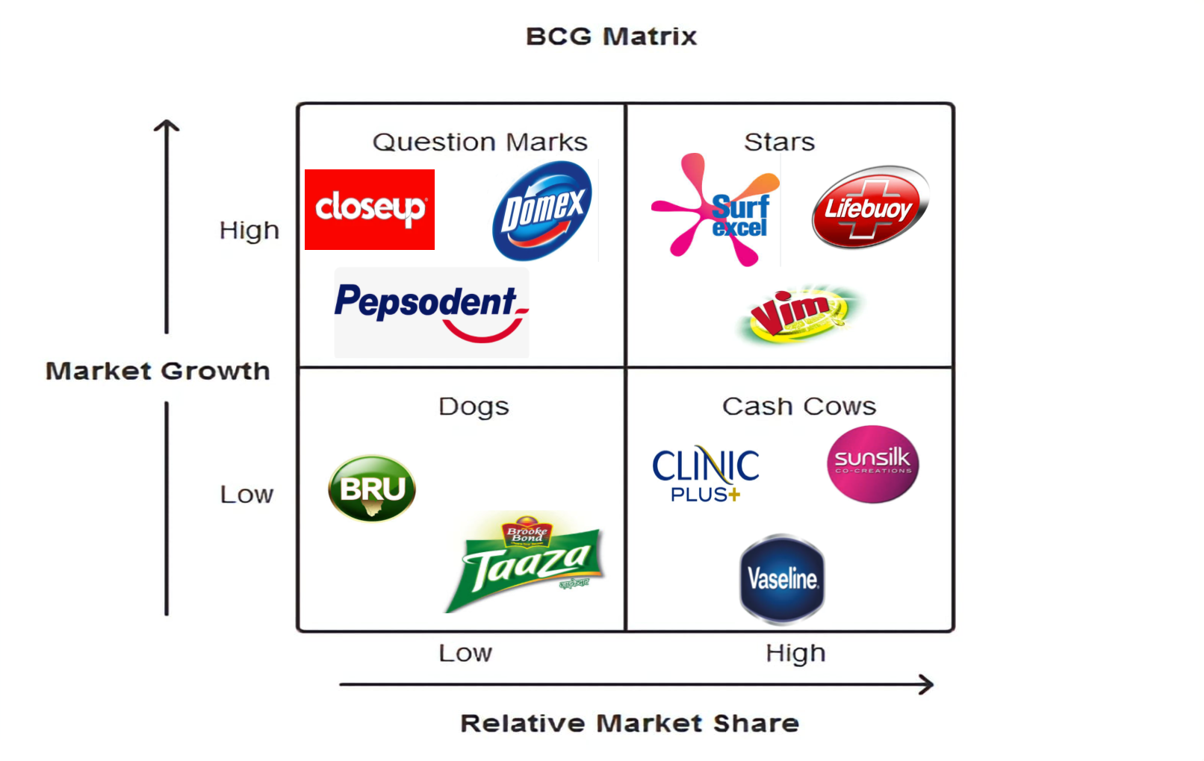
MODELS FOR PORTFOLIO ANALYSIS
HUL IN THE BCG MATRIX
Boston Consulting Group (BCG) Matrix
Common Models
Four Categories
Concept
.
The BCG Matrix evaluates businesses based on two variables: market growth rate and relative market share.
Vertical: Market Growth Rate (high to low)
Horizontal: Relative Market Share (high to low)
STARS: High market share, high growth (e.g., Surf excel).
CASH COWS: High market share, low growth (e.g., Closeup).
QUESTION MARKS: Low market share, high growth (e.g., Sunsilk).
DOGS: Low market share, low growth (e.g., Taaza).
GE Multifactor Portfolio Matrix
Evaluate business performance and inform strategic decisions regarding investment and resource allocation.
It helps businesses understand their product’s strengths and weaknesses and make strategic decisions about their product lines.
Purpose
Axes Explanation

Slide 9
STRATEGIC IMPLICATIONS OF BCG MATRIX
HUL IN THE BCG MATRIX
Four Categories
Common Models
Investment
Concept
.
The BCG Matrix evaluates businesses based on two variables: market growth rate and relative market share.
Vertical: Market Growth Rate (high to low)
Horizontal: Relative Market Share (high to low)
STARS: High market share, high growth (e.g., Surf excel).
CASH COWS: High market share, low growth (e.g., Closeup).
QUESTION MARKS: Low market share, high growth (e.g., Sunsilk).
DOGS: Low market share, low growth (e.g., Taaza).
STARS: Require reinvestment to maintain market share and support growth.
CASH COWS: Generate cash for reinvestment into stars and question marks.
QUESTION MARKS: Require careful evaluation; decide whether to invest or divest.
DOGS: Consider divestment or harvesting to free up resources.
Purpose
Axes Explanation

Slide 10
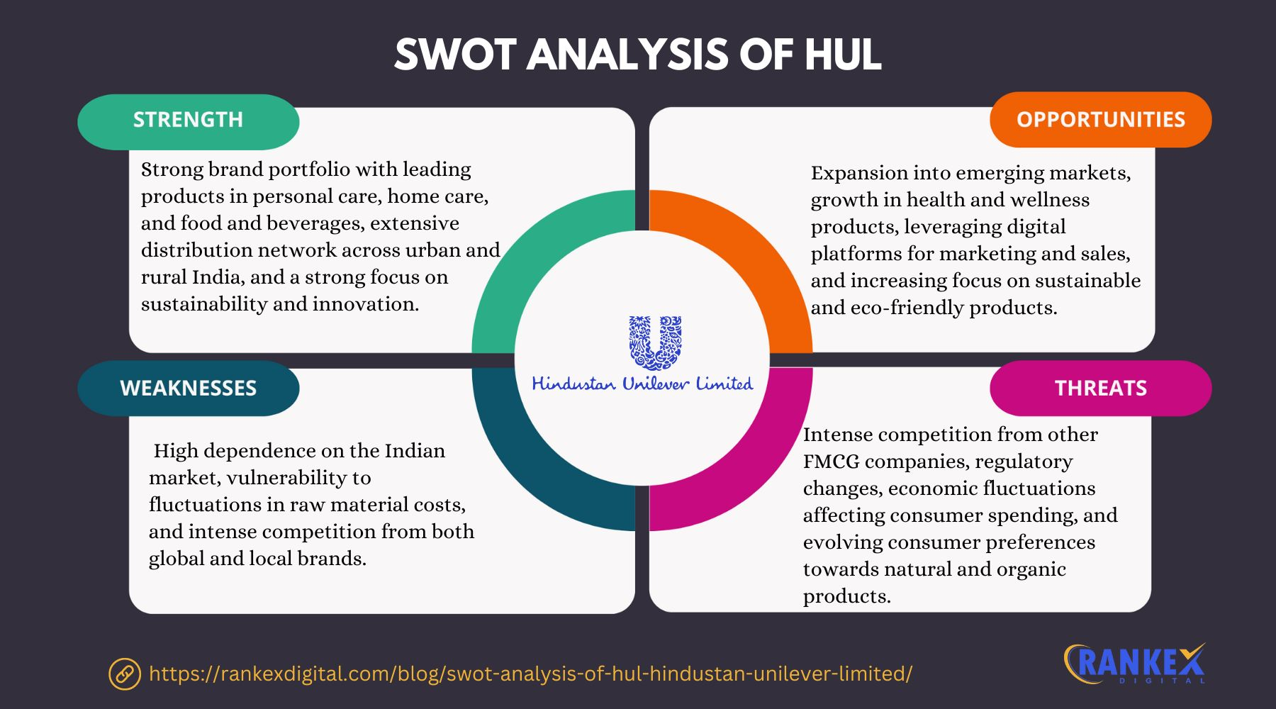
STRATEGIC IMPLICATIONS OF BCG MATRIX
HUL IN THE BCG MATRIX
Four Categories
Common Models
Concept
.
Investment
The BCG Matrix evaluates businesses based on two variables: market growth rate and relative market share.
Vertical: Market Growth Rate (high to low)
Horizontal: Relative Market Share (high to low)
STARS: High market share, high growth (e.g., Surf excel).
CASH COWS: High market share, low growth (e.g., Closeup).
QUESTION MARKS: Low market share, high growth (e.g., Sunsilk).
DOGS: Low market share, low growth (e.g., Taaza).
STARS: Require reinvestment to maintain market share and support growth.
CASH COWS: Generate cash for reinvestment into stars and question marks.
QUESTION MARKS: Require careful evaluation; decide whether to invest or divest.
DOGS: Consider divestment or harvesting to free up resources.
Purpose
Axes Explanation

Slide 11
STRATEGIC IMPLICATIONS OF BCG MATRIX
Investment
STARS: Require reinvestment to maintain market share and support growth.
CASH COWS: Generate cash for reinvestment into stars and question marks.
QUESTION MARKS: Require careful evaluation; decide whether to invest or divest.
DOGS: Consider divestment or harvesting to free up resources.
Common Models
Concept
.
The BCG Matrix evaluates businesses based on two variables: market growth rate and relative market share.
Vertical: Market Growth Rate (high to low)
Horizontal: Relative Market Share (high to low)
Purpose
Axes Explanation

Slide 12


GE MULTIFACTOR PORTFOLIO MATRIX OVERVIEW

Slide 13
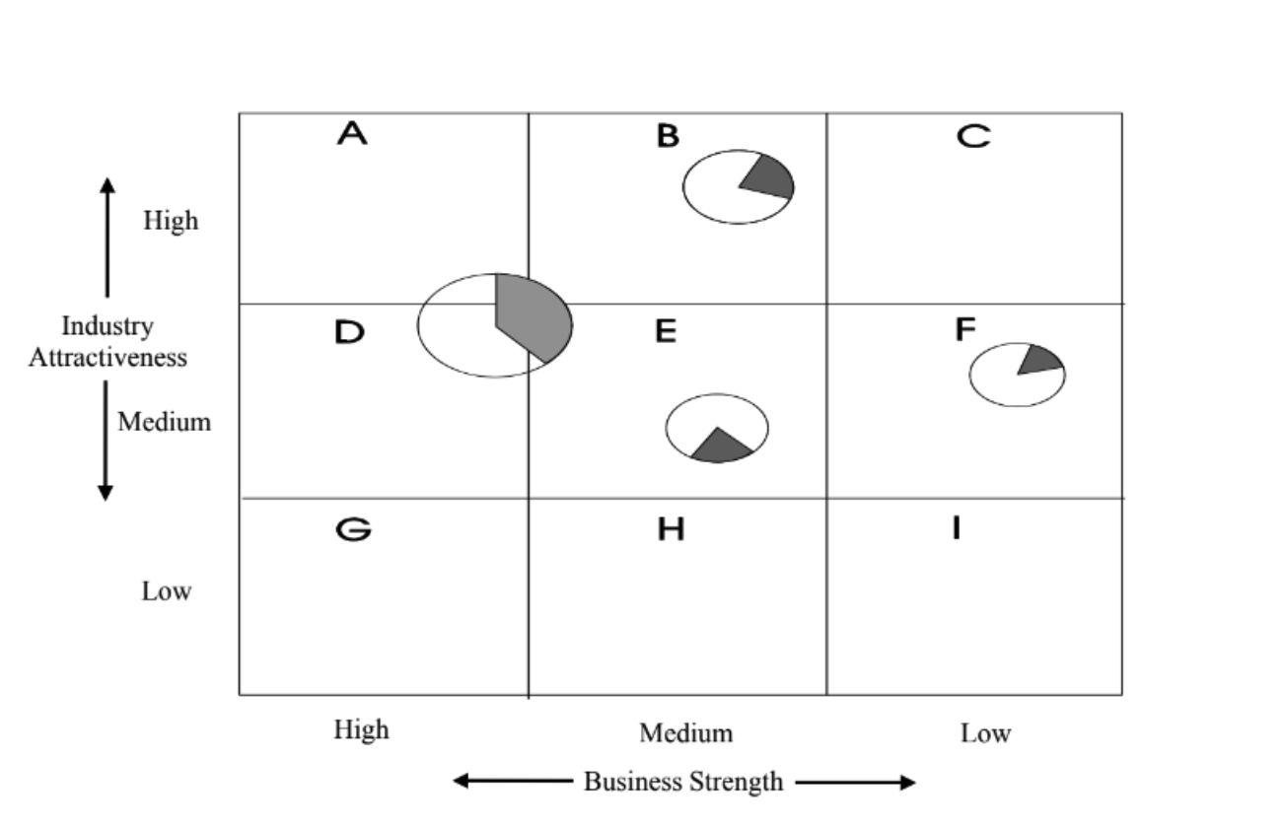
GE MULTIFACTOR PORTFOLIO MATRIX OVERVIEW
Concept
The GE Matrix evaluates SBUs based on industry attractiveness and business strength.
Vertical: Industry Attractiveness (high to low)
Horizontal: Business Strength (high to low)
Axes Explanation

Slide 14
GE MULTIFACTOR PORTFOLIO MATRIX OVERVIEW
GE MATRIX EVALUATION FACTORS
Concept
Industry Attractiveness factors
The GE Matrix evaluates SBUs based on industry attractiveness and business strength.
Vertical: Industry Attractiveness (high to low)
Horizontal: Business Strength (high to low)
Market size, growth rate, profitability, competitive intensity, technological requirements.
Market share, growth rate, brand image, distribution efficiency, product quality.
Business Strength Factors
Axes Explanation

Slide 15
GE MULTIFACTOR PORTFOLIO MATRIX OVERVIEW
HUL’s POSITION IN THE GE MATRIX
STRATEGIC RECOMMENDATIONS FROM GE MATRIX
FUTURE OUTLOOK FOR HUL
GE MATRIX EVALUATION FACTORS
FINANCIAL PERFORMANCE OVERVIEW
Concept
ANALYSIS OF HUL’s SBUs
Growing consumer demand for sustainable and health-focused
products.
Increasing penetration of digital and e-commerce platforms.
Innovations in product offerings (e.g., natural ingredients, health
foods).
Expansion into new geographic markets.
Industry Attractiveness factors
Investment Recommendations
Key Metrics
The GE Matrix evaluates SBUs based on industry attractiveness and business strength.
Vertical: Industry Attractiveness (high to low)
Horizontal: Business Strength (high to low)
High Attractiveness/High Strength:
Market size, growth rate, profitability, competitive intensity, technological requirements.
Market share, growth rate, brand image, distribution efficiency, product quality.
Invest further in SBUs that show high attractiveness and strength.
Selective investment in medium attractiveness/strength areas based
on potential.
Consider harvesting or divesting low attractiveness/strength
segments to optimize resource allocation.
Dove, Surf Excel: strong growth and market position.
New health products: Potential for growth, requires investment.
Certain underperforming segments that may need divestment.
REVENUE TRENDS: Consistent growth driven by strong brands.
PORFITABILITY: Healthy margins, particularly in cash cow segments.
MARKET SHARE ANALYSIS: Dominance in several product categories.
Medium Attractiveness/Strength:
Growth Opportunities
Business Strength Factors
Axes Explanation
Low Attractiveness/Strength:

Slide 16
GE MULTIFACTOR PORTFOLIO MATRIX OVERVIEW
HUL’s POSITION IN THE GE MATRIX
STRATEGIC RECOMMENDATIONS FROM GE MATRIX
FUTURE OUTLOOK FOR HUL
GE MATRIX EVALUATION FACTORS
FINANCIAL PERFORMANCE OVERVIEW
ANALYSIS OF HUL’s SBUs
Growing consumer demand for sustainable and health-focused
products.
Increasing penetration of digital and e-commerce platforms.
Innovations in product offerings (e.g., natural ingredients, health
foods).
Expansion into new geographic markets.
Industry Attractiveness factors
Investment Recommendations
Key Metrics
High Attractiveness/High Strength:
Market size, growth rate, profitability, competitive intensity, technological requirements.
Market share, growth rate, brand image, distribution efficiency, product quality.
Invest further in SBUs that show high attractiveness and strength.
Selective investment in medium attractiveness/strength areas based
on potential.
Consider harvesting or divesting low attractiveness/strength
segments to optimize resource allocation.
Dove, Surf Excel: strong growth and market position.
New health products: Potential for growth, requires investment.
Certain underperforming segments that may need divestment.
REVENUE TRENDS: Consistent growth driven by strong brands.
PORFITABILITY: Healthy margins, particularly in cash cow segments.
MARKET SHARE ANALYSIS: Dominance in several product categories.
Medium Attractiveness/Strength:
Growth Opportunities
Business Strength Factors
Low Attractiveness/Strength:

Slide 17
GE MULTIFACTOR PORTFOLIO MATRIX OVERVIEW
HUL’s POSITION IN THE GE MATRIX
STRATEGIC RECOMMENDATIONS FROM GE MATRIX
FUTURE OUTLOOK FOR HUL
GE MATRIX EVALUATION FACTORS
FINANCIAL PERFORMANCE OVERVIEW
ANALYSIS OF HUL’s SBUs
Growing consumer demand for sustainable and health-focused
products.
Increasing penetration of digital and e-commerce platforms.
Innovations in product offerings (e.g., natural ingredients, health
foods).
Expansion into new geographic markets.
Industry Attractiveness factors
Investment Recommendations
Key Metrics
High Attractiveness/High Strength:
Market size, growth rate, profitability, competitive intensity, technological requirements.
Market share, growth rate, brand image, distribution efficiency, product quality.
Invest further in SBUs that show high attractiveness and strength.
Selective investment in medium attractiveness/strength areas based
on potential.
Consider harvesting or divesting low attractiveness/strength
segments to optimize resource allocation.
Dove, Surf Excel: strong growth and market position.
New health products: Potential for growth, requires investment.
Certain underperforming segments that may need divestment.
REVENUE TRENDS: Consistent growth driven by strong brands.
PORFITABILITY: Healthy margins, particularly in cash cow segments.
MARKET SHARE ANALYSIS: Dominance in several product categories.
Medium Attractiveness/Strength:
Growth Opportunities
Business Strength Factors
Low Attractiveness/Strength:

Slide 18
GE MULTIFACTOR PORTFOLIO MATRIX OVERVIEW
HUL’s POSITION IN THE GE MATRIX
STRATEGIC RECOMMENDATIONS FROM GE MATRIX
FUTURE OUTLOOK FOR HUL
GE MATRIX EVALUATION FACTORS
FINANCIAL PERFORMANCE OVERVIEW
ANALYSIS OF HUL’s SBUs
Growing consumer demand for sustainable and health-focused
products.
Increasing penetration of digital and e-commerce platforms.
Innovations in product offerings (e.g., natural ingredients, health
foods).
Expansion into new geographic markets.
Industry Attractiveness factors
Investment Recommendations
Key Metrics
High Attractiveness/High Strength:
Market size, growth rate, profitability, competitive intensity, technological requirements.
Market share, growth rate, brand image, distribution efficiency, product quality.
Invest further in SBUs that show high attractiveness and strength.
Selective investment in medium attractiveness/strength areas based
on potential.
Consider harvesting or divesting low attractiveness/strength
segments to optimize resource allocation.
Dove, Surf Excel: strong growth and market position.
New health products: Potential for growth, requires investment.
Certain underperforming segments that may need divestment.
REVENUE TRENDS: Consistent growth driven by strong brands.
PORFITABILITY: Healthy margins, particularly in cash cow segments.
MARKET SHARE ANALYSIS: Dominance in several product categories.
Medium Attractiveness/Strength:
Growth Opportunities
Business Strength Factors
Low Attractiveness/Strength:

Slide 19
HUL’s POSITION IN THE GE MATRIX
STRATEGIC RECOMMENDATIONS FROM GE MATRIX
FUTURE OUTLOOK FOR HUL
GE MATRIX EVALUATION FACTORS
FINANCIAL PERFORMANCE OVERVIEW
ANALYSIS OF HUL’s SBUs
Growing consumer demand for sustainable and health-focused
products.
Increasing penetration of digital and e-commerce platforms.
Innovations in product offerings (e.g., natural ingredients, health
foods).
Expansion into new geographic markets.
Industry Attractiveness factors
Investment Recommendations
Key Metrics
High Attractiveness/High Strength:
Market size, growth rate, profitability, competitive intensity, technological requirements.
Market share, growth rate, brand image, distribution efficiency, product quality.
Invest further in SBUs that show high attractiveness and strength.
Selective investment in medium attractiveness/strength areas based
on potential.
Consider harvesting or divesting low attractiveness/strength
segments to optimize resource allocation.
Dove, Surf Excel: strong growth and market position.
New health products: Potential for growth, requires investment.
Certain underperforming segments that may need divestment.
REVENUE TRENDS: Consistent growth driven by strong brands.
PORFITABILITY: Healthy margins, particularly in cash cow segments.
MARKET SHARE ANALYSIS: Dominance in several product categories.
Medium Attractiveness/Strength:
Growth Opportunities
Business Strength Factors
Low Attractiveness/Strength:

Slide 20

CHALLENGES FACED BY HUL
Potential Risks
Economic fluctuations affecting consumer spending.
Supply chain disruptions impacting product availability.
Evolving regulatory landscape affecting operations.

Slide 21
CHALLENGES FACED BY HUL
Potential Risks
Economic fluctuations affecting consumer spending.
Supply chain disruptions impacting product availability.
Evolving regulatory landscape affecting operations.

Slide 22
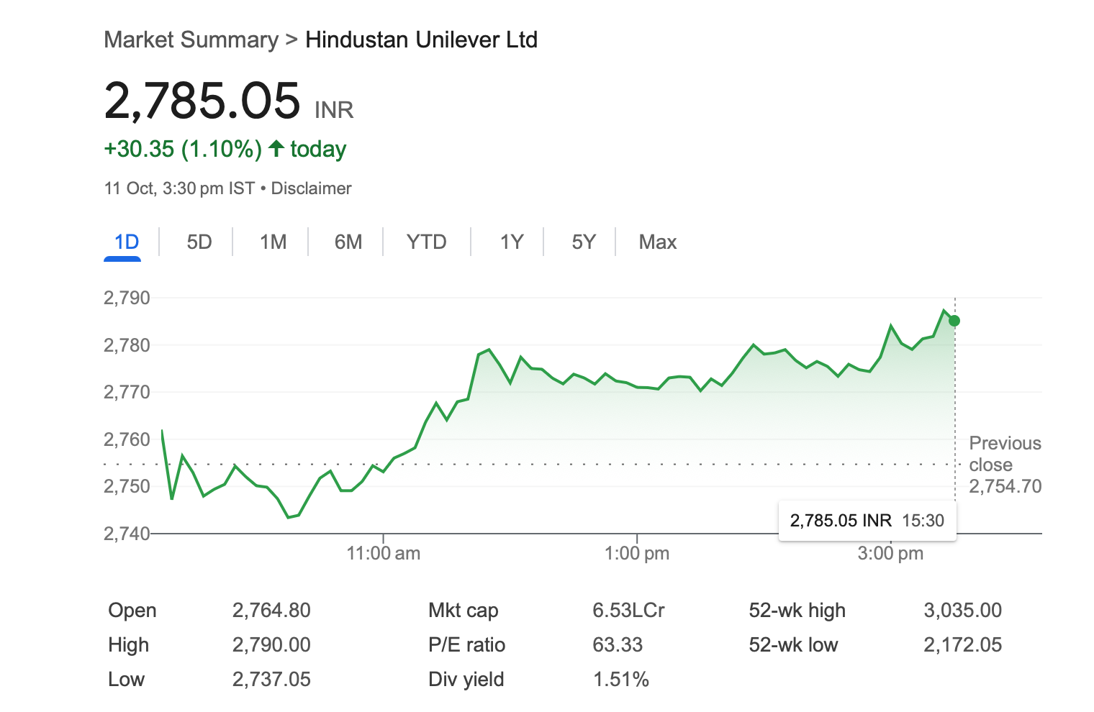
CONCLUSION
Summary of Analysis
HUL’s strategic positioning reflects a well-managed portfolio.
Ongoing portfolio assessment is crucial for maintaining market leadership.
Strategic investments in growth areas can sustain competitive advantage.

Slide 23
CONCLUSION
Summary of Analysis
HUL’s strategic positioning reflects a well-managed portfolio.
Ongoing portfolio assessment is crucial for maintaining market leadership.
Strategic investments in growth areas can sustain competitive advantage.

Slide 24
Q&A
Difference between stars and dogs?
Which of HUL’s product categories do you think holds the most potential for future growth, and why?
Which product do you think is the biggest opportunity for HUL right now?

Slide 25
THANK YOU
THANK YOU
THANK YOU
PPT DESIGN CREDITS - Shanmukh

